Slide 1

ANALYSIS OF VARIOUS PROPERTIES OF GASES
Project Members
Sahul Rajhansa : 888260114
Sanket Ranawade : 887415321
Aditi Patil : 887465649

Slide 2

Objective:
To Develop a best predictive model to check if there is a functional relationship between the measured physical properties (Tm, Pr, Th, Sv) and a chemical index, Idx by using two methods: the linear and nonlinear method i.e Linear regression and Polynomial regression.

Slide 3
Methods Used:
LINEAR REGRESSION
POLYNOMIAL REGRESSION

Slide 4
Linear Regression
Linear regression algorithm shows a linear relationship between a dependent (y) and one or more independent (y) variables, hence called as linear regression.
Mathematical Representation of linear regression:
y= a0+a1x+ ε

Slide 5
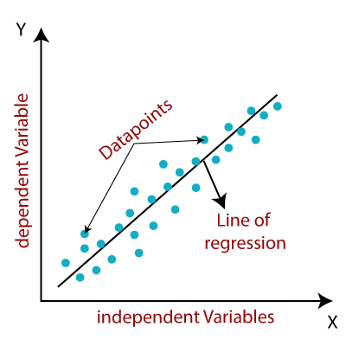
Independent Variables: Tm, Pr, Th, Sv Dependent Variable: Idx

Slide 6
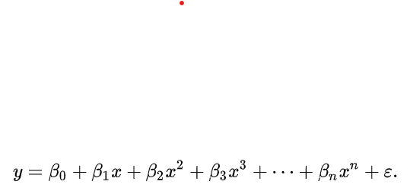
Polynomial regression:
It is a regression algorithm that models the relationship between a dependent(y) and independent variable(x) as nth degree polynomial. The Polynomial Regression equation is given below:

Slide 7

Polynomial models may have unanticipated turns in inappropriate directions

Slide 8
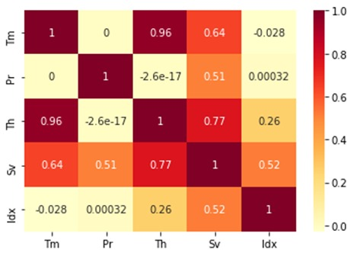
Heatmap of correlation matrix

Slide 9
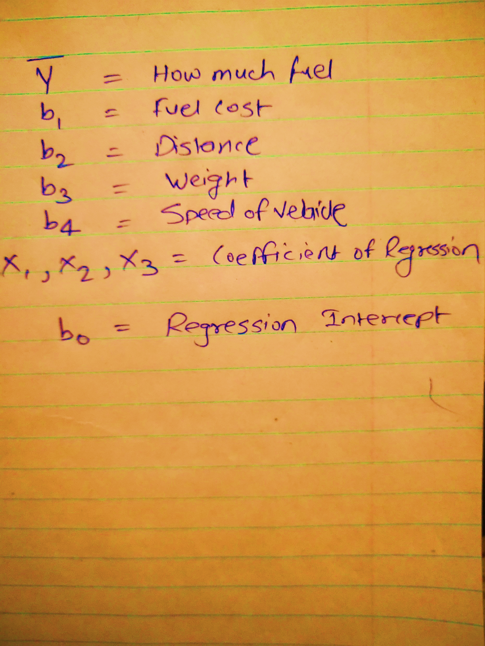
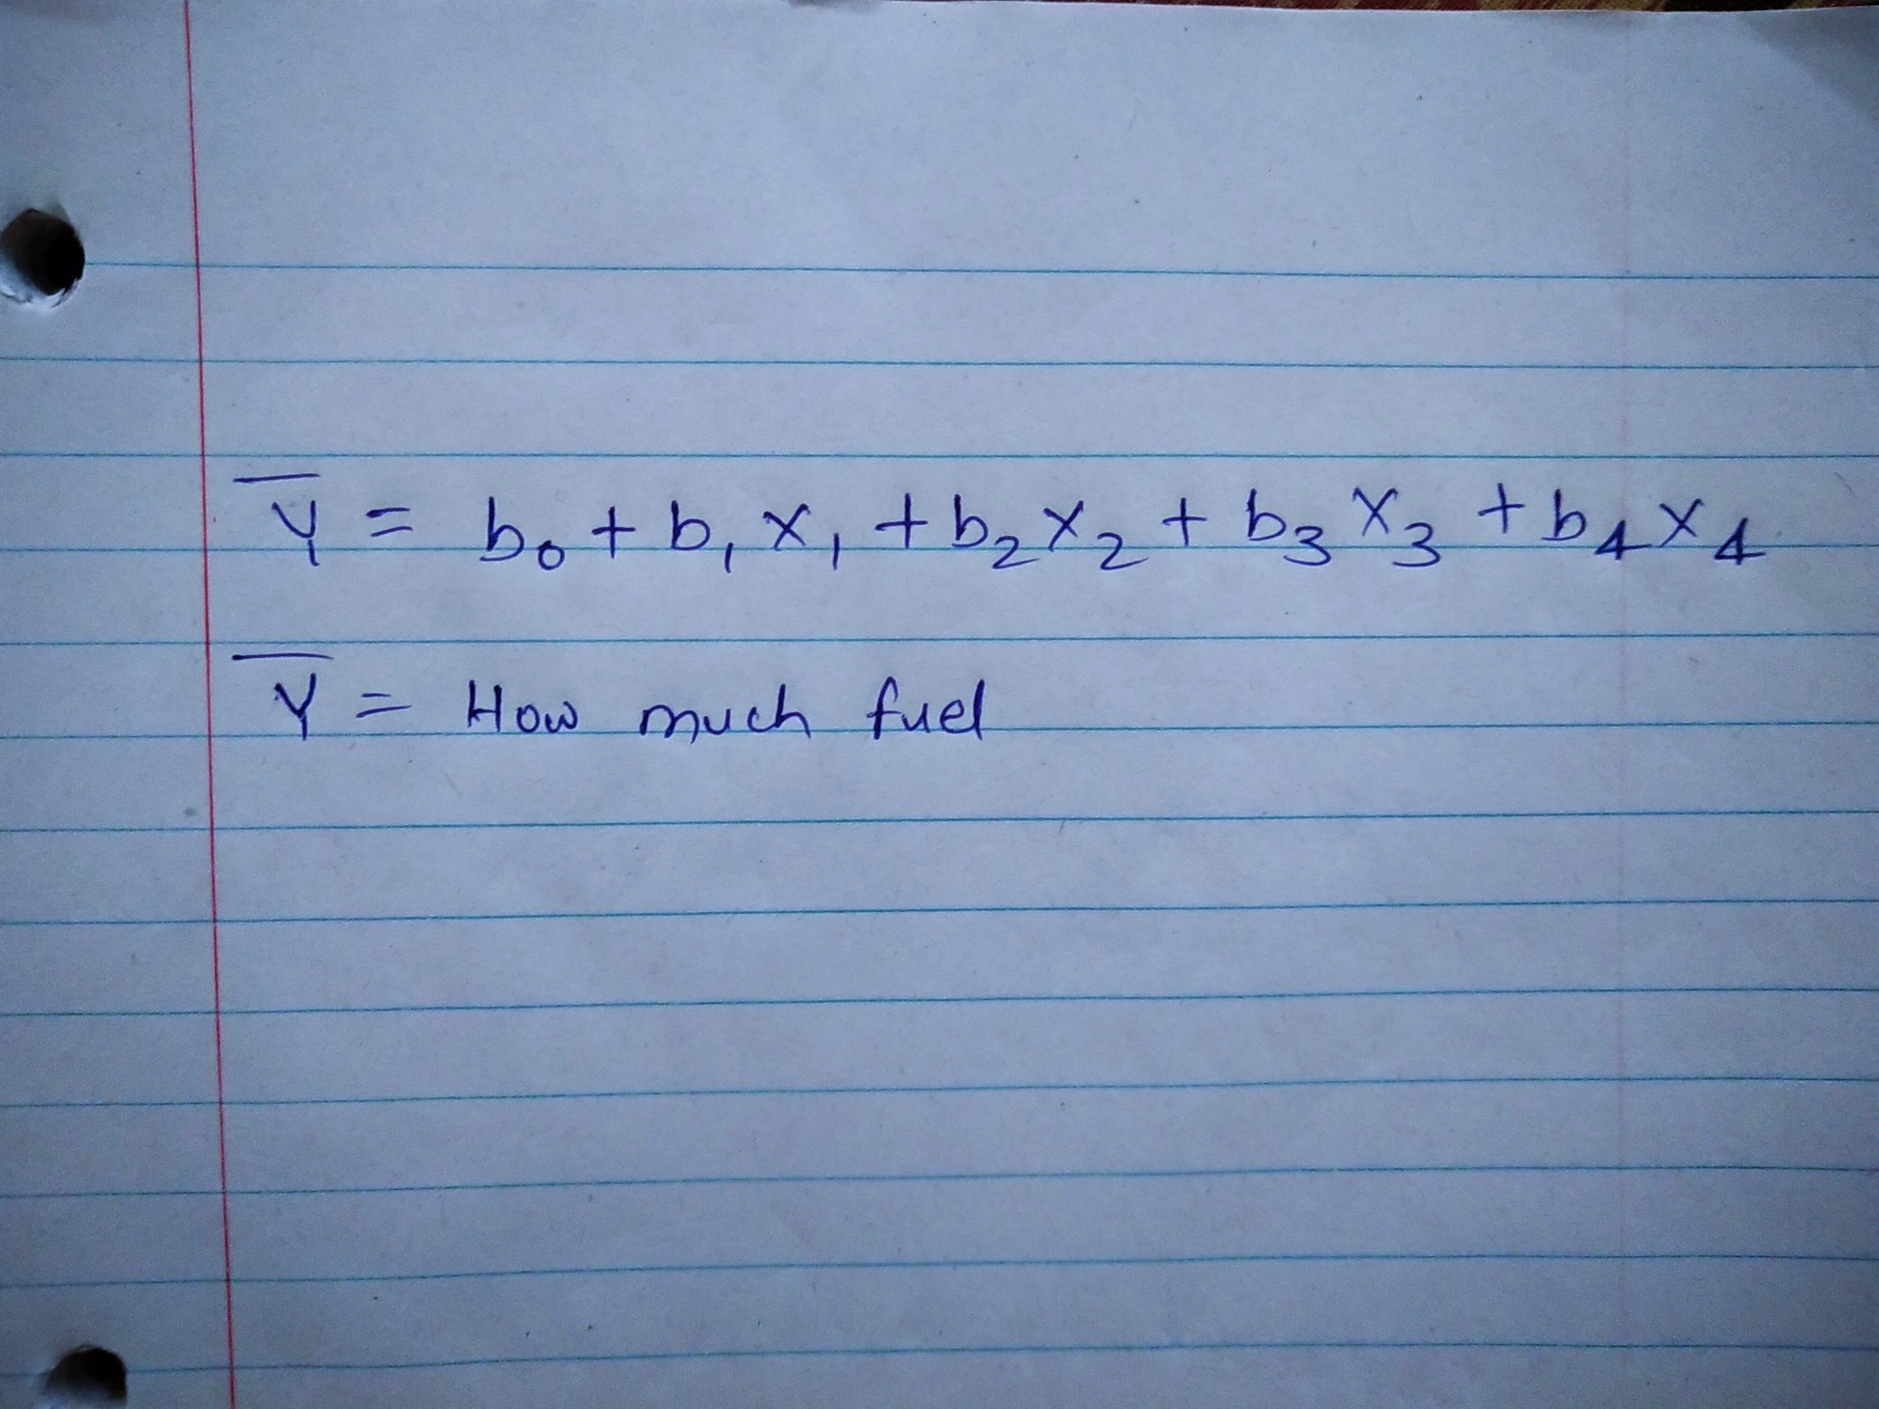
Algorithms:
Linear Regression:
Polynomial Regression:
R2 SCORE

Slide 10
Technologies used:
IDE Spyder
Language: Python
Algorithms: Linear Regression, Polynomial Regression.
Scientific Library: Anaconda
Relative Packages: Pandas, numpy, sklearn, Matplotlib
Dataset: MS Excel- csv file

Slide 11
RESULT COMPARISON
Linear Regression Output
Scores:
0.9783321790408116
0.9732533362890612
0.9757403443209168
Best score obtained by linear Regression:
0.9783321790408116

Slide 12
Polynomial Regression Output
Degree 2 R2 score: 0.9977539113087113
Degree 3 R2 score: 0.9983082871799924
Degree 4 R2 score: 0.9984137806008117
Degree 5 R2 score: 0.9984526964574567
Degree 6 R2 score: 0.9983208330315125

Slide 13
Conclusion
Polynomial Regression is better fit for the dataset as compared to Linear Regression.
Result obtained closely at Degree 5.

Slide 14
THANK YOU

